Slide 1
Categorical Variables

Slide 2
Learning Objectives
  How to include categorical variables in regression?
  What is the interpretation of the coefficients of categorical variables?
  How to model interaction between categorical and numerical variables?

Slide 3
Example: Forecasting

Slide 4

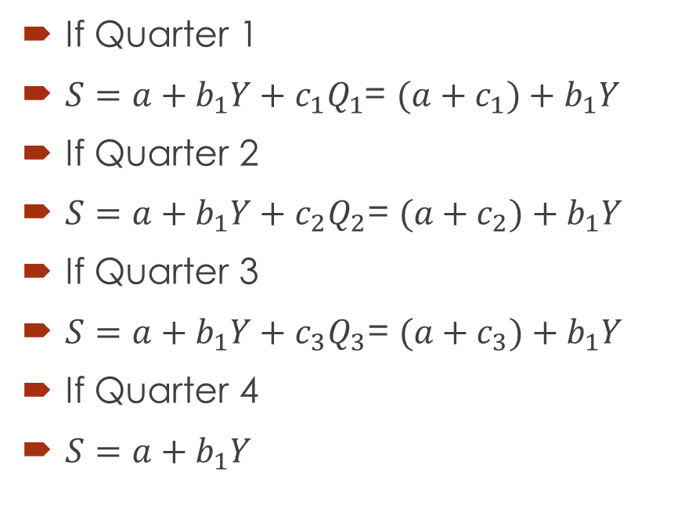
Data and Model
Q | Sales | Year(Y) | Q1 | Q2 | Q3
1 | 170 | 1 | 1 | 0 | 0
2 | 148 | 1 | 0 | 1 | 0
3 | 141 | 1 | 0 | 0 | 1
4 | 150 | 1 | 0 | 0 | 0
1 | 161 | 2 | 1 | 0 | 0
2 | 137 | 2 | 0 | 1 | 0
3 | 132 | 2 | 0 | 0 | 1
4 | 158 | 2 | 0 | 0 | 0
1 | 157 | 3 | 1 | 0 | 0
2 | 145 | 3 | 0 | 1 | 0
3 | 128 | 3 | 0 | 0 | 1
4 | 134 | 3 | 0 | 0 | 0
1 | 160 | 4 | 1 | 0 | 0
2 | 139 | 4 | 0 | 1 | 0
3 | 130 | 4 | 0 | 0 | 1
4 | 144 | 4 | 0 | 0 | 0
$$S=a+b_{1}Y+c_{1}Q_{1}+c_{2}Q_{2}+c_{3}Q_{3}$$
If Quarter 1
$S=a+b_{1}Y+c_{1}Q_{1}$= $(a+c_{1})+b_{1}Y$
If Quarter 2
$S=a+b_{1}Y+c_{2}Q_{2}\text{= }(a+c_{2})+b_{1}Y$
If Quarter 3
$S=a+b_{1}Y+c_{3}Q_{3}\text{= }(a+c_{3})+b_{1}Y$
If Quarter 4
$S=a+b_{1}Y$

Slide 5
Regression Results
Regression Statistics
Multiple R | 0.9205
R Square | 0.8473
Adjusted R Square | 0.7917
Standard Error | 5.7263
Observations | 16
 | Coefficients | Standard Error | t Stat | P-value
Intercept | 154.75 | 4.2948 | 36.0324 | 0.0000
Year | -3.3 | 1.2804 | -2.5772 | 0.0257
Q1 | 15.5 | 4.0491 | 3.8280 | 0.0028
Q2 | -4.25 | 4.0491 | -1.0496 | 0.3164
Q3 | -13.75 | 4.0491 | -3.3958 | 0.0060
Launch Poll 2
Notes:
Poll 2: What is the interpretation of the intercept (154.75)?

Slide 6
Example: Salary Discrimination
  Case “Gender Divide”
  200 obs.
Is there a gender discrimination? Are male and female employees paid differently?
How to test for discrimination?

Slide 7
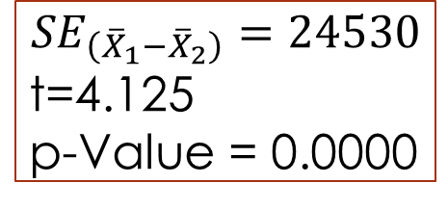
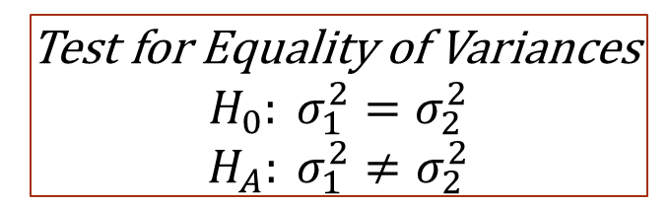
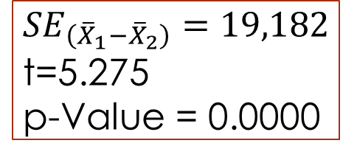
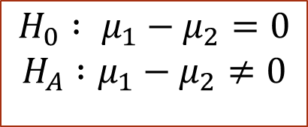
Two Sample Mean Test
Gender | N | Mean | Std. Deviation
Male | 66 | 545,158 | 191,287
Female | 134 | 443,981 | 79,626
Test for Equality of Variances
$${H_{0}: σ}_{1}^{2}=σ_{2}^{2}$$
$${H_{A}: σ}_{1}^{2}≠σ_{2}^{2}$$
F = 191,287²/79626² = 5.77
p-Value = 0.0000
Test for Equality of means
Assume Equality of Variances
$$H_{0} : μ_{1}−μ_{2}=0$$
$$H_{A} :μ_{1}−μ_{2}≠0$$
$${SE}_{\left({\overline{X}}_{1}−{\overline{X}}_{2}\right)}=24530$$
t=4.125
p-Value = 0.0000
$${SE}_{\left({\overline{X}}_{1}−{\overline{X}}_{2}\right)}=19,182$$
t=5.275
p-Value = 0.0000
Conclusion?

Slide 8
ANOVA
 | Sum of Squares | df | Mean Square | F | Sig.
Between Groups | 4.5267E+11 | 1 | 4.5267E+11 | 27.8206 | 0.0000
Within Groups | 3.2217E+12 | 198 | 1.6271E+10
Total | 3.6743E+12 | 199

Slide 9
Categorical Predictor Variables
Gender is categorical (nominal, qualitative) and not quantitative (numerical) variable, which we have been using until now
We can use dummy (or binary) variables
  Can take one of only two values, typically coded as 0 and 1
  If there are more than two categories, we use multiple dummies
Consider the model: Salary = β₀ + β₁ Female + ε
  Female = 1 for Women employees, Female= 0 for Male employees
For two categories, we create one dummy variable
Other examples
  Seasonality (month effects) in sales
  Industry sector effects in stock returns
  Doctor effects in quality of care
  Before and after liberalization

Slide 10

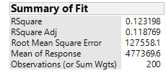
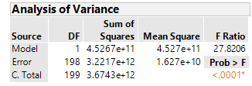
Regression with a Dummy Variable
 | Mean
 | Male | Female
Salary | 545,158 | 443,981
Salary = 545,158 -101,177 Female
How do we interpret the coefficients? Is there evidence for discrimination?

Slide 11

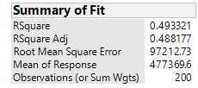
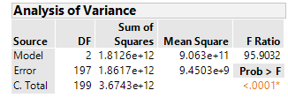
Controlling for Years of Experience
Launch Poll 1
Salary = 440,769.58 – 96,986.77 Female +11,757 Exp
How do we interpret the coefficients? Is there evidence for discrimination?

Slide 12
Interaction Between Experience and Gender
Shifting the Slope
Does salary increase at different rates with experience for males and females?
Create a new variable Female*Exp as the product of the Female and Experience columns
This variable which is a product of two predictor variables, is called an interaction term
  Female*Exp = Experience for female employees
  Female*Exp = 0 for male employees
Consider the model:
Salary = β₀ + β₁Female + β₂Exp + β₃Female*Exp + ε

Slide 13
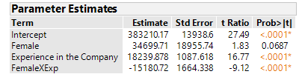
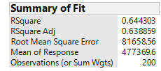

Regression With Interaction Terms
Salary = 383,210.17 + 34,699.71 Female + 18239.88 Experience – 15,180.72 FemaleXExp
What is the interpretation of the coefficient of Female*Exp?

Slide 14
“Controlling” for Type of Degree
The Type of degree is also likely to have a significant effect on the salary
Type of Degree is a categorical variable that can take values from 1 to 5 (Arts, Commerce, Science, Technology, PostGrad)
To include Type of Degree in the regression, we need to create Four more dummy variables –Commerce, Science, Technology, PostGrad.
In general, if there are m categories for the variable, we need to create (m-1) dummy variables.
The one category for which dummy is not created serves as the control or reference category
We are also adding another dummy variable for “Analytics” Knowledge
  Analytics = 1 if NO knowledge

Slide 15
Creating Dummies For Multiple (>2) Categories
Coding of dummy variable for Type of degree
What’s the control in this case?
We get the following model:
Salary = β₀ + β₁ Female + β₂ Experience + β₃ Fem*Exp + β₄ Commerce + β₅ Science + β₆ Technology + β₇ PostGrad + β₈ Analytics + ε
Actual Degree | Dummy Variable for
 | Commerce | Science | Technology | Post Grad
Commerce | 1 | 0 | 0 | 0
Science | 0 | 1 | 0 | 0
Technology | 0 | 0 | 1 | 0
Post Grad | 0 | 0 | 0 | 1
Arts | 0 | 0 | 0 | 0

Slide 16
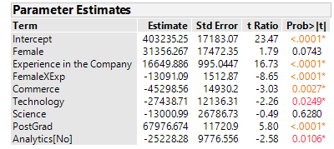
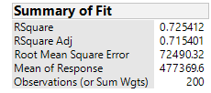
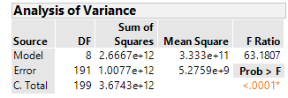
The Estimated Model

Slide 17
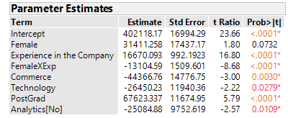

Final Model with Step-wise

Slide 18
Summary of Session
  Categorical variables can be included by creating binary/dummy variables in regression
  For m categories, you need m-1 dummy variables and the remaining one acts as a reference or control category
  Coefficients of categorical variables capture the average difference in the response variable between the category of interest and the reference category
  Interaction between categorical and numerical variables can be modeled by calculating a new variable that is product of the two variables
  Interaction captures the difference in association between the response variable and the numerical variable for different categories
  How to include categorical variables in regression?
  What is the interpretation of the coefficients of categorical variables?
  How to model interaction between categorical and numerical variables?

Slide 19
Questions?

